Slide 1

Manufacturing Companies

Slide 2
What is Manufacturing?
Manufacturing is the Production of goods in large quantities after processing of raw materials to more vulnerable products.
Manufacturing is the process of transforming materials or components into finished products that can be sold in the marketplace. Every physical product that you buy in a store or online is manufactured somewhere.
In simple, Manufacturing is the process of transformation of raw material into finished goods
EXAMPLES
paper from wood
sugar from sugarcane

Slide 3
Why we need manufacturing?
Manufacturing sector is considered the backbone of development because
It helps people by providing jobs in secondary and tertiary sectors.
Industrial development helps in eradication of unemployment and poverty from our country.
Export of manufactured goods expands trade and commerce , and brings in much needed foreign exchange.

Slide 4

Types of Manufacturing Industries
Clothing and Textiles
Petroleum, Chemicals and Plastics
Electronics, Computers
Food Production
Metal Manufacturing
Wood, Leather and Paper
Transportation
Furniture
Building Materials etc.

Slide 5
Trends Dominate Manufacturing in 2021
Employee Safety Becomes a Top Priority
IoT is (Still) THE Big Thing
Predictive Maintenance Keeps Production on Track
Shifting Focus from B2B to B2C
Manufacturers Gain Greater Visibility into Big Data
VR (virtual reality)& AR(augmented reality) Support Touchless Service Model
3D Printing Makes Production Faster & Cheaper

Slide 6
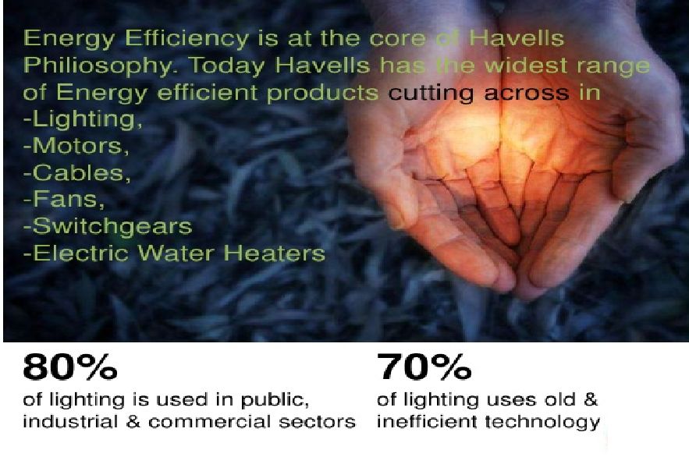
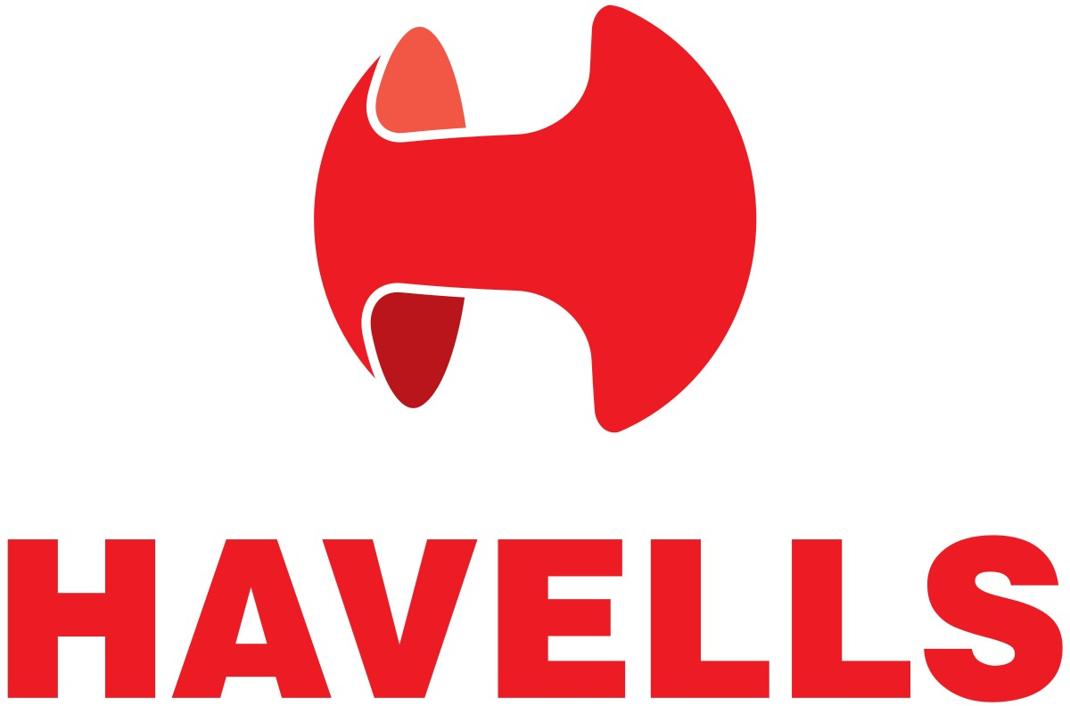
Havells India Ltd

Slide 7
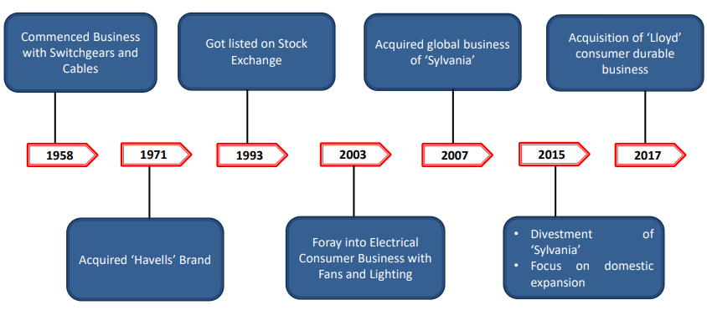
AN EVOLVING JOURNEY

Slide 8
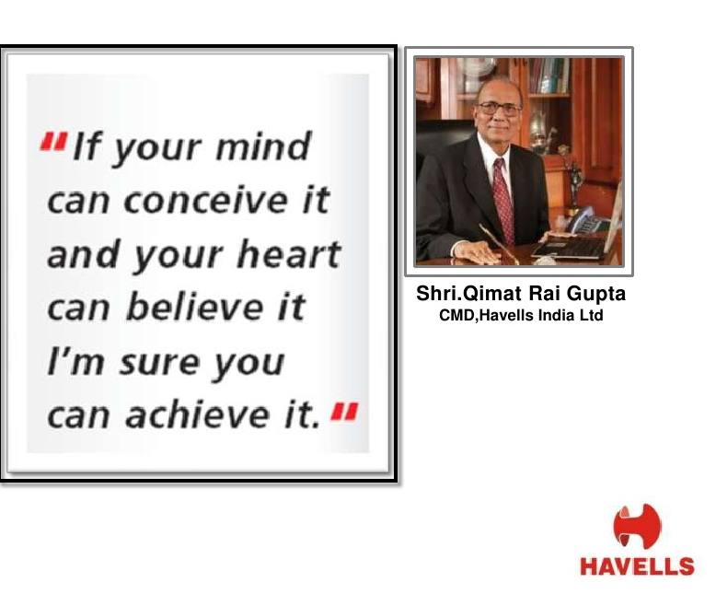

Slide 9
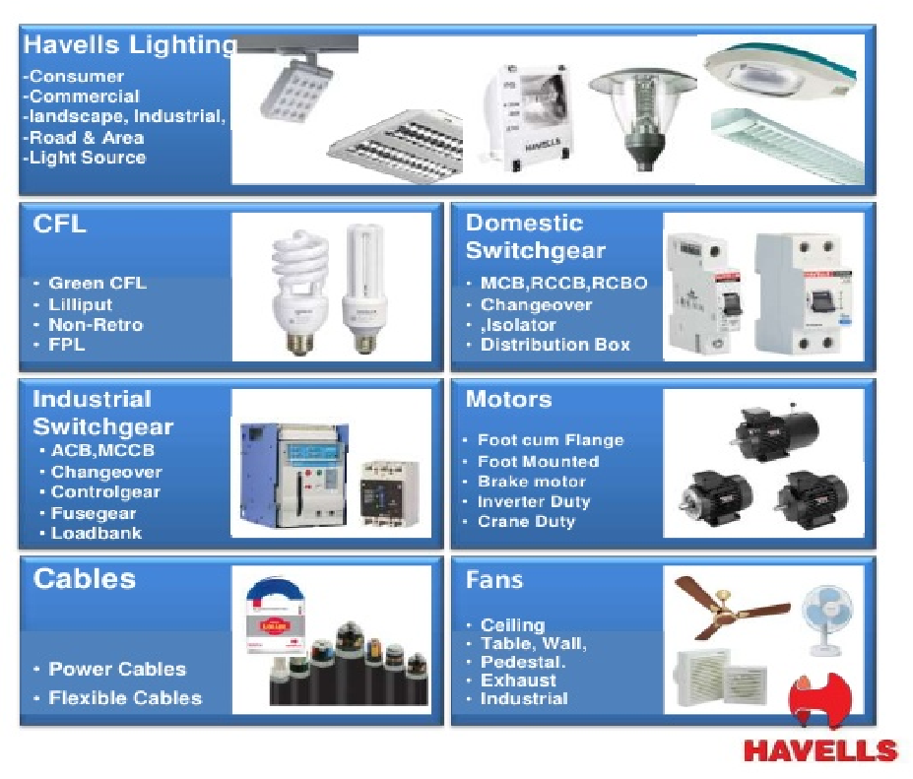
OVERVIEW
Havells India Ltd. is a billion-dollar-plus organization, and is one of the largest & India's fastest growing electrical and power distribution equipment manufacturer with products ranging from Industrial & Domestic Circuit Protection Switchgear, Cables & Wires, Motors, Fans, Power Capacitors, CFL Lamps, Luminaires for Domestic, Commercial & Industrial applications, Modular Switches, & Bath fittings covering the entire gamut of household, commercial and industrial electrical needs. Havells owns some of the prestigious global brands like Crabtree, Sylvania, Concord, Luminance, Linotile, & SLI Lighting.

Slide 10
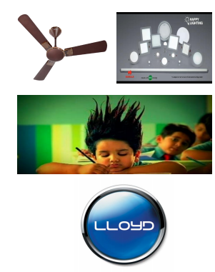
KEY MILESTONES
➢ Leverage channel by expanding product portfolio
✓ Industrial to a consumer company
➢ Manufacturing
✓ Large scale manufacturing with high standards of quality assurance
✓ ~90% in-house
➢ National Advertising and uniform discounting
✓ Disproportionate ad spend on ’non-consumer’ products
➢ Mass to ‘mass premium’
✓ Steady premiumization
➢ Acquisition of Sylvania and pragmatic exit
✓ Changing industry dynamics and capital allocation
➢ Lloyd Acquisition
✓ Entry into high potential Large Consumer Durables
✓ Aligned with ‘Deeper into Homes’

Slide 11
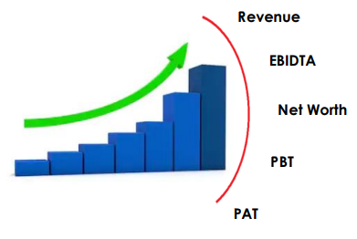
CONSISTENT DELIVERY
Financial performance
➢ Growth during last 20 years:
✓ Revenue- 103x
✓ Profit- 221x
✓ Asset base- 215x
➢ Deb free- net cash positive

Slide 12
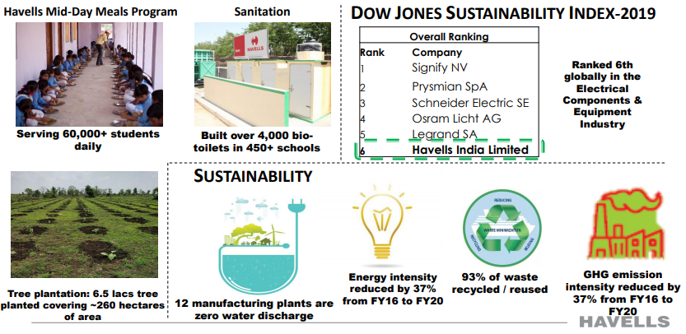
GROWTH WITH RESPONSIBILTY

Slide 13
BENCHMARKING WITH THE BEST CORPORATE AND SHAREHOLDERS GOVERNANCE
➢ Committed to high standards of corporate governance
➢ Well experienced and diversified professional Board
➢ Promoters- single business focus
➢ Transparent and detailed communication to shareholders
KEY LEVERS
• Distribution
•Product extension and expansion
• Digitization
• Research & Development

Slide 14
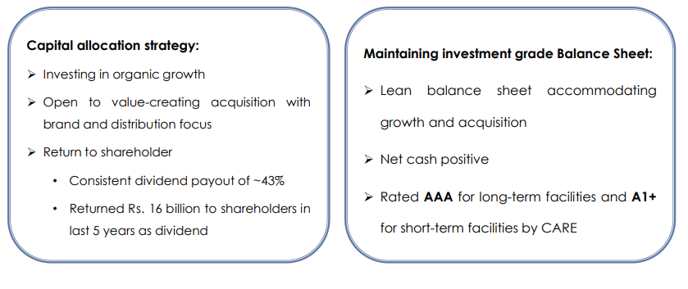
PRUDENT FINANCIAL MANAGEMENT

Slide 15
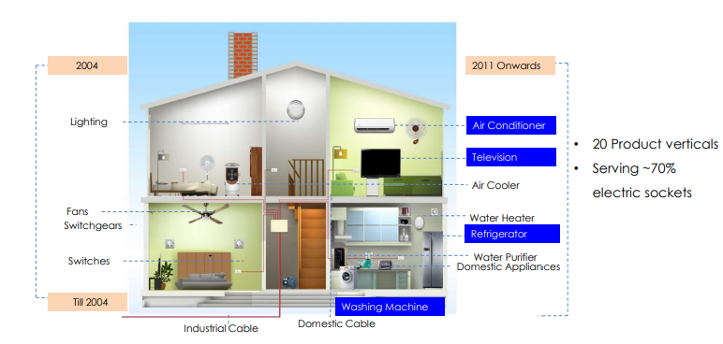
DEEPER INTO HOMES

Slide 16
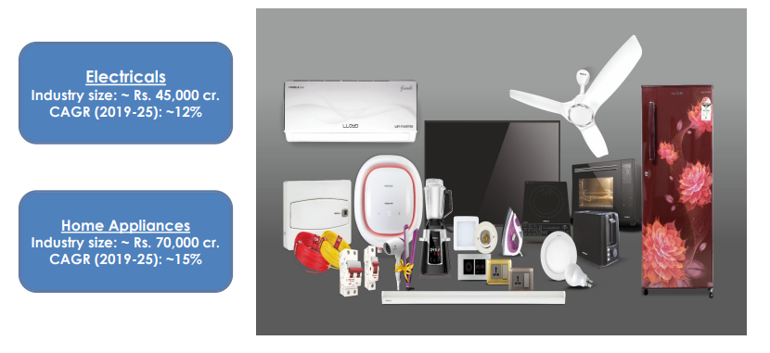
WIDEST CONSUMER OFFERING

Slide 17
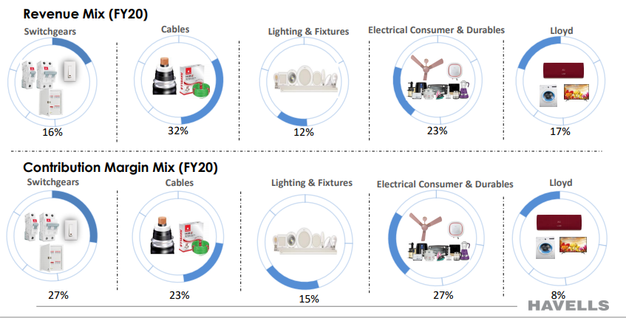
SEGMENTS

Slide 18
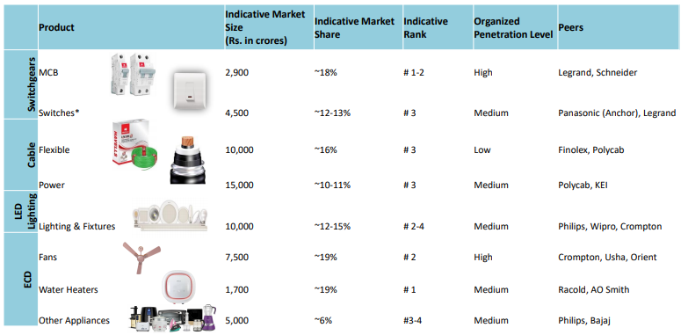
MARKET SHARE: TOP 3 ACROSS CATEGORIES

Slide 19
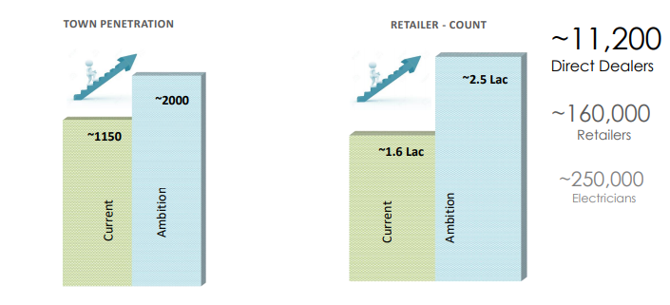
DISTRIBUTION: DEEPER PENETRATION
Proximity to Consumer

Slide 20
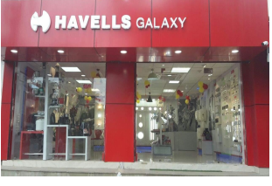
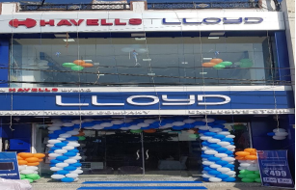
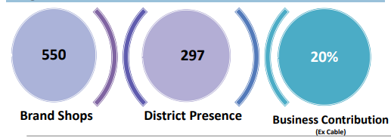
DISTRIBUTION: MULTI CHANNEL
➢ Grow inclusively :
✓ MBOs
✓ Brand stores
✓ Organized retail chains
✓ Canteen Stores
✓ Projects & Enterprise Business
✓ E-commerce
Largest Brand Shop channel in electrical industry

Slide 21
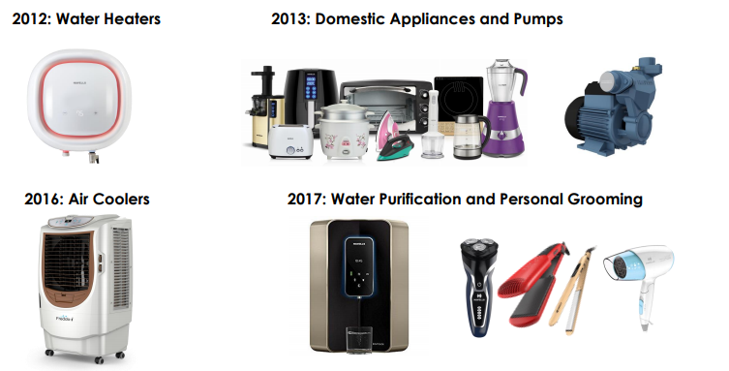
CONSISTENT NEW PRODUCT INTRODUCTIONS

Slide 22
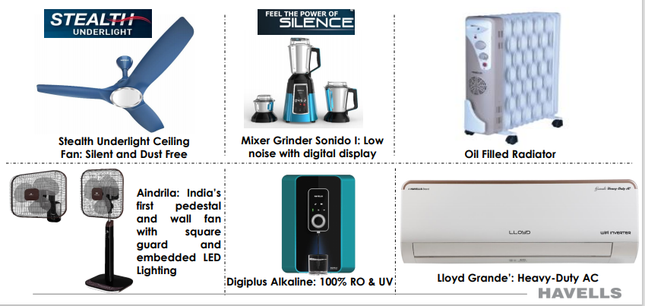
SERVED WITH REGULAR FRESH LAUNCHES

Slide 23
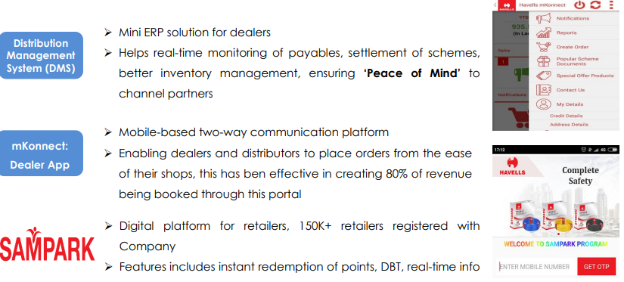
DIGITIZATION: SALES PROCESS

Slide 24
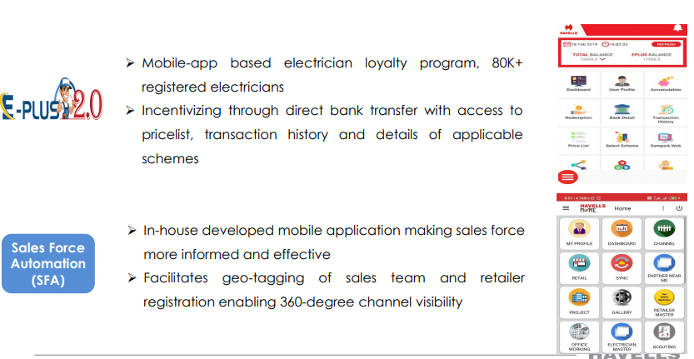
DIGITIZATION: SALES PROCESS

Slide 25
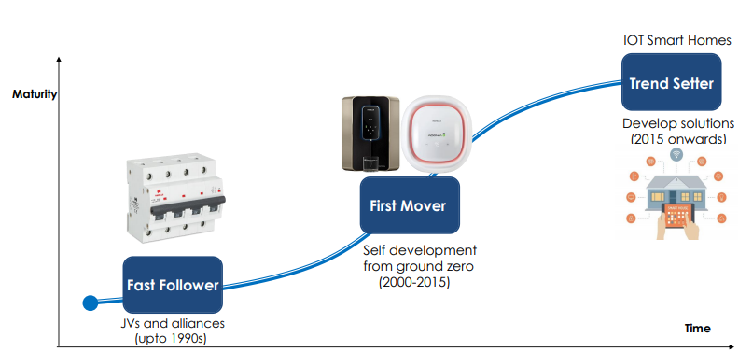
RESEARCH AND DEVELOPMENT
➢ Fast catcher to thought leadership
➢ R&D spend to increase from 1% to 3% of net revenue
➢ Intelligent hardware, embedded software
➢ Products to solution

Slide 26
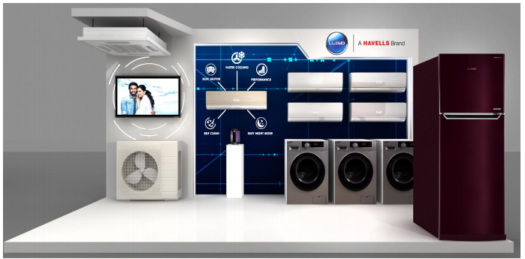
LLOYD
A full stack consumer appliances play

Slide 27
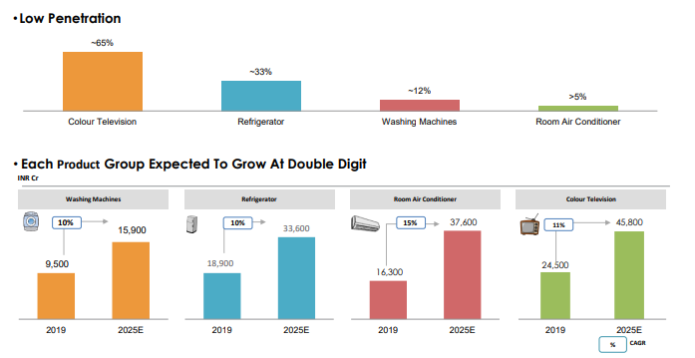
HIGH GROWTH POTENTIAL INDUSTRY

Slide 28
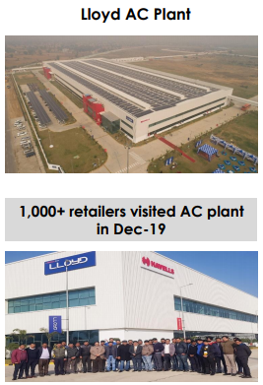
LLOYD: JOURNEY SO FAR
➢ Since Lloyd acquisition Lloyd AC Plant in 2017, there have been structural
improvements in business amidst significant industry disruptions
➢ The industry turned fiercely competitive, led by price erosion by
leading players in the market
➢ Lloyd, in midst of transition, was adversely impacted by increase in
costs - higher import duty, adverse forex fluctuations and higher
marketing & advertising costs
➢ The resultant price increase by Lloyd, led to moderation in
volumes
➢ Lloyd has, however, managed to improve brand imagery,
expanded distribution network, reduced forex exposure through
AC plant commissioning, and is proliferating product range with
washing machines and refrigerators

Slide 29
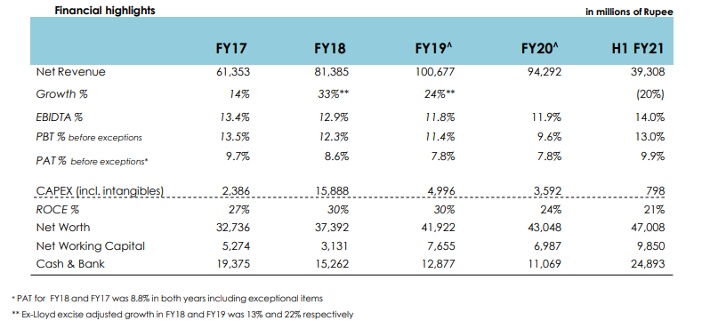
FINANCIALS
STANDALONE FINANCIALS

Slide 30
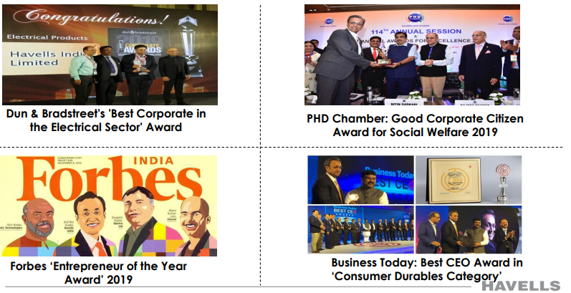
RECENT RECOGNITIONS

Slide 31
SUMMARY
➢ India represents large untapped opportunity with lower penetration, higher unorganized sector & growing electrification
➢ Havells preparing for future with constant products expansion, deepening market reach & brand reinforcement
➢ Organic leverage with opportunistic acquisition to drive growth
➢ Strengthening management bandwidth to lead ambitious growth plan
➢ Native business acumen, market connect and ethics remain core values

